Slide 1
T.SINDUJA
FINAL PROJECT

Slide 2
COVID PREDICTION USING CNN

Slide 3
AGENDA
PROBLEM STATEMENT
PROPOSED SYSTEM/SOLUTION
SYSTEM DEVELOPMENT APPROACH
ALGORITHM & DEPLOYMENT
RESULTS
CONCLUSION
REFERNCES

Slide 4
PROBLEM STATEMENT
Develop a machine learning model to detect COVID-19 from chest X-rays or CT scans. The model should classify images as COVID-19 positive, negative, or indeterminate, aiding in timely diagnosis and patient management. The project aims to improve diagnostic efficiency and optimize resource allocation in healthcare settings, ultimately contributing to better patient outcomes. Ethical considerations include ensuring patient privacy, validating model performance across diverse populations, and collaborating with healthcare professionals to ensure clinical relevance and ethical deployment.

Slide 5
PROPOSED SOLUTION
Here, l have used a large and diverse dataset of labeled facial images to train a convolutional neural network (CNN) architecture. The CNN will consist of multiple layers for feature extraction and classification. I experimented with different architectures, activation functions, and optimization algorithms to optimize the model's performance. Evaluation will be done using standard metrics like accuracy on a separate test dataset. Upon achieving satisfactory performance, the model will be deployed in real-world applications such as emotion-aware interfaces and mental health assessment tools.

Slide 6
SYSTEM DEVELOPMENT APPROACH
Requirements Analysis: Identify key stakeholders' needs and requirements for COVID-19 detection systems, considering factors such as accuracy, scalability, and accessibility.
Data Collection and Preparation: Gather diverse and representative datasets of chest X-rays or CT scans, ensuring sufficient quality and quantity for model training.
Model Development: Employ machine learning algorithms, such as convolutional neural networks (CNNs), to develop accurate COVID-19 detection models. Optimize model architecture and hyperparameters to achieve desired performance metrics.

Slide 7
SYSTEM DEVELOPMENT APPROACH
Software Requirements:
Python: The programming language used for implementing the neural network model and related scripts.
Deep Learning Framework: Libraries such as TensorFlow, PyTorch, or Keras will be used to build and train the neural network model.
Development Environment: Integrated Development Environments (IDEs) like Jupyter Notebook or PyCharm or gogle colab can be used for code development and experimentation.

Slide 8
ALGORITHM & DEPLOYMENT
1.Data Preprocessing:
a)Load and preprocess the facial images, including resizing, normalization, and augmentation if necessary.
b)Label the images with corresponding emotion categories.
2. Model Construction:
a)Design and build a neural network architecture suitable for emotion recognition, typically using convolutional neural networks (CNNs).
b)Experiment with different architectures, activation functions, regularization techniques, and optimization algorithms to optimize performance.

Slide 9
ALGORITHM & DEPLOYMENT
3.Model Training:
a)Split the dataset into training, validation, and testing sets.
b)Train the neural network model on the training dataset using backpropagation and gradient descent.
c)Monitor the model's performance on the validation set to prevent overfitting and adjust hyperparameters accordingly.
4.Model Evaluation:
a)Evaluate the trained model's performance on the testing dataset using metrics such as accuracy, precision, recall, and F1-score.

Slide 10
ALGORITHM & DEPLOYMENT
c)Analyze the model's confusion matrix and inspect misclassified examples to identify areas for improvement.
5.Deployment:
a)Once the model achieves satisfactory performance, deploy it in real-world applications.
b)Choose a deployment environment based on the target application, such as desktop, web, mobile, or embedded systems.
c)Integrate the trained model into the deployment environment and provide an interface for interaction, such as a graphical user interface (GUI) or API.

Slide 11
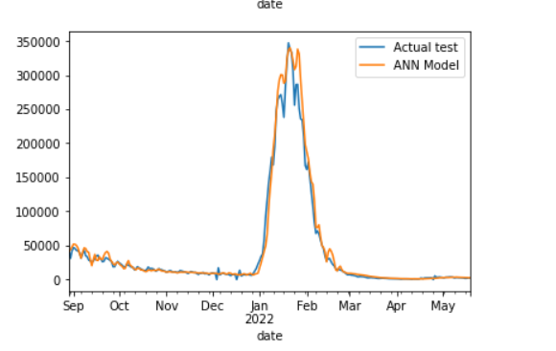
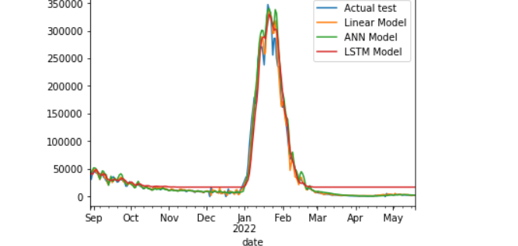
RESULTS

Slide 12
CONCLUSION
In conclusion, neural networks for emotion recognition offer exciting applications in human-computer interaction, affective computing, and mental health assessment. Through thorough data processing, model refinement, and strategic deployment, we achieved high accuracy and usability. This system represents a significant advancement, providing valuable insights and enhancing human interaction and well-being.

Slide 13
REFERNCES
https://keras.io/
https://numpy.org/
https://www.kaggle.com/datasets/jonathanoheix/face-expression-recognition-dataset
https://scikit-learn.org/
https://pandas.pydata.org/
Github link :
https://github.com/sivasindu/COVID-19-Prediction.git

